Slide 1
Stabilization via Backstepping
With VDP example

Slide 2

Goal: Design state feedback control to stabilize origin!
$$\dot{η}=f_{a}\left(η\right)+g_{a}\left(η\right)ζ$$
$$\dot{ζ}=f_{b}\left(η,ζ\right)+g_{b}\left(η,ζ\right)u$$
States and input
Choose input $ζ=φ(η)$ to stabilize Lyapunov function
$$\frac{∂V_{a}}{∂η}\left[f_{a}\left(η\right)+g_{a}\left(η\right)φ(η)\right]=\dot{{\dot{V}}_{a}}≤−W(η)$$
Change of variable
$$z=ζ−φ(η)$$
New system is:
$$\dot{η}=f_{a}\left(η\right)+g_{a}\left(η\right)(φ\left(η\right)+z)$$
$$\dot{z}=f_{b}\left(η,ζ\right)−\frac{∂φ}{∂η}\dot{η}+g_{b}\left(η,ζ\right)u$$
New Lyapunov function on new system:
$$V=V_{a}+\frac{1}{2}z^{2}=\frac{1}{2}η^{2} +\frac{1}{2}{\left(ζ−φ\left(η\right)\right)}^{2}$$
$$\dot{V}=\frac{∂V_{a}}{∂η}\left[f_{a}\left(η\right)+g_{a}\left(η\right)φ\left(η\right)\right]+\frac{∂V_{a}}{∂η}g_{a}\left(η\right)z+\left(f_{b}\left(η,ζ\right)−\frac{∂φ}{∂η}\dot{η}\right)z+g_{b}\left(η,ζ\right)uz$$
Stabilizing control law is then:
$$u=−\frac{1}{g_{b}\left(η,ζ\right)}\left[\frac{∂V_{a}}{∂η}g_{a}\left(η\right)+f_{b}\left(η,ζ\right)−\frac{∂φ}{∂η}\dot{η}+kz\right]$$
VDP example
$${\dot{x}}_{1}=\frac{1}{ε}x_{2}, ε>0$$
$${\dot{x}}_{2}=ε\left[−x_{1}+x_{2} −\frac{1}{3}x_{2}^{3}\right]+εu$$

Slide 3
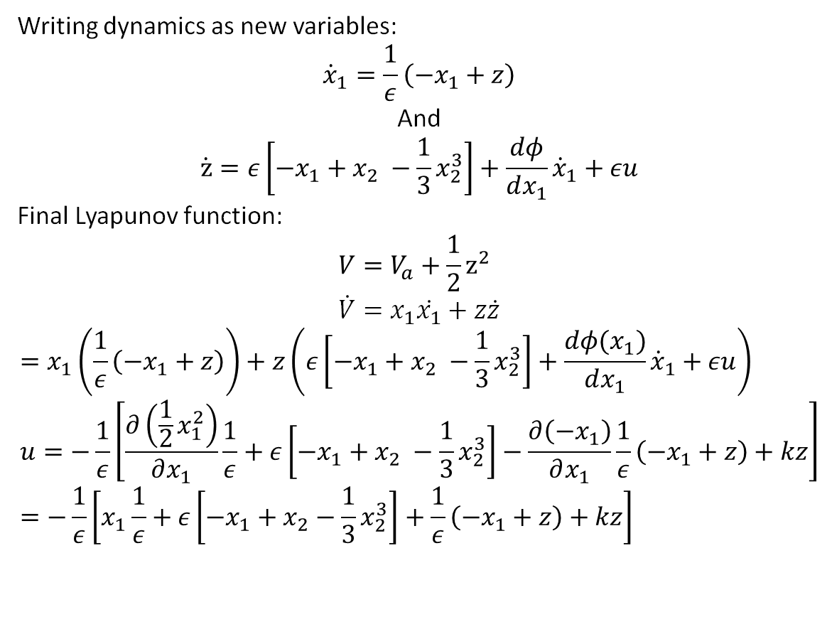
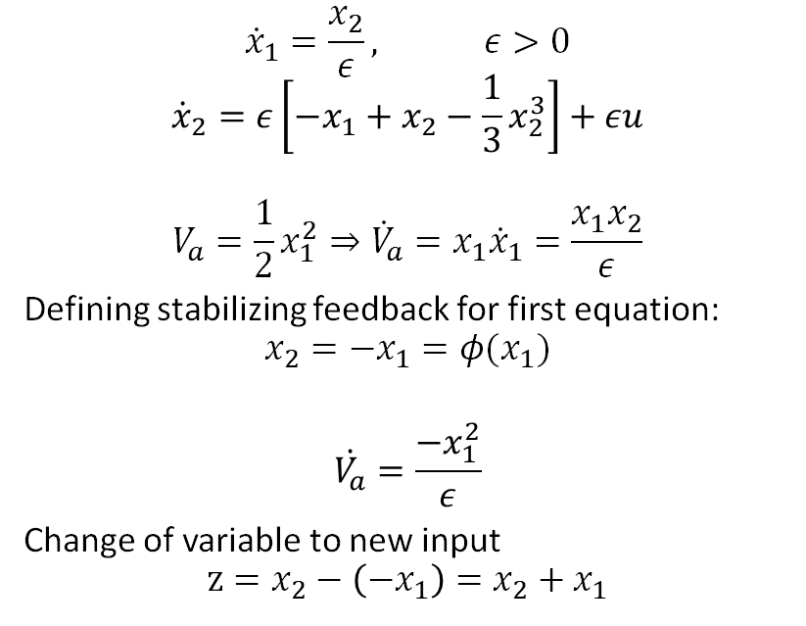
Writing dynamics as new variables:
$${\dot{x}}_{1}=\frac{1}{ε}\left(−x_{1}+z\right)$$
And
$$\dot{z}=ε\left[−x_{1}+x_{2} −\frac{1}{3}x_{2}^{3}\right]+\frac{dφ}{dx_{1}}{\dot{x}}_{1}+εu$$
Final Lyapunov function:
$$V=V_{a}+\frac{1}{2}z^{2} \\ \dot{V}=x_{1}\dot{x_{1}}+z\dot{z}$$
$$=x_{1}\left(\frac{1}{ε}\left(−x_{1}+z\right)\right)+z\left(ε\left[−x_{1}+x_{2} −\frac{1}{3}x_{2}^{3}\right]+\frac{dφ(x_{1})}{dx_{1}}{\dot{x}}_{1}+εu\right) \\ u=−\frac{1}{ε}\left[\frac{∂\left(\frac{1}{2}x_{1}^{2}\right)}{∂x_{1}}\frac{1}{ε}+ε\left[−x_{1}+x_{2} −\frac{1}{3}x_{2}^{3}\right]−\frac{∂\left(−x_{1}\right)}{∂x_{1}}\frac{1}{ε}\left(−x_{1}+z\right)+kz\right] \\ =−\frac{1}{ε}\left[x_{1}\frac{1}{ε}+ε\left[−x_{1}+x_{2}−\frac{1}{3}x_{2}^{3}\right]+\frac{1}{ε}\left(−x_{1}+z\right)+kz\right]$$
$${\dot{x}}_{1}=\frac{x_{2}}{ε}, ε>0$$
$${\dot{x}}_{2}=ε\left[−x_{1}+x_{2}−\frac{1}{3}x_{2}^{3}\right]+εu$$
$$V_{a}=\frac{1}{2}x_{1}^{2}⇒{\dot{V}}_{a}=x_{1}{\dot{x}}_{1}=\frac{x_{1}x_{2}}{ε}$$
Defining stabilizing feedback for first equation:
$$x_{2}=−x_{1}=φ(x_{1})$$
$$\dot{V_{a}}=\frac{−x_{1}^{2}}{ε}$$
Change of variable to new input
$$z=x_{2}−\left(−x_{1}\right)=x_{2}+x_{1}$$

